Slide 1
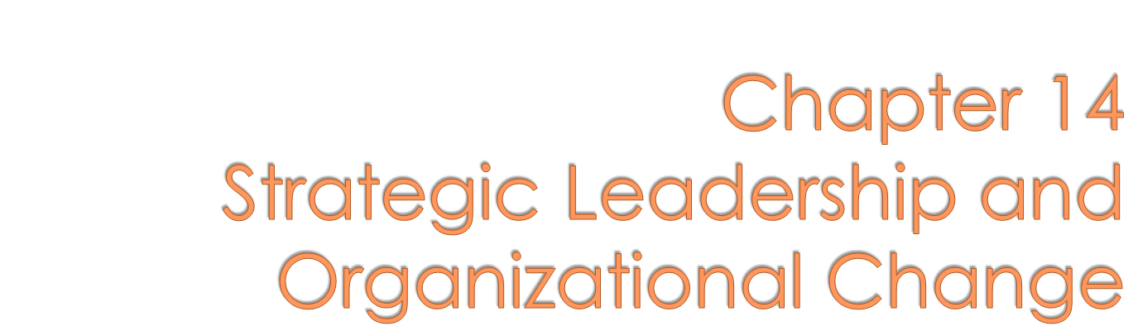



Slide 2

What is moral leadership?
What is shared leadership?
How do you lead across cultures?
What is strategic leadership?
How do you lead organizational change?
Copyright © 2010 John Wiley & Sons, Inc.
14-<number>

Slide 3

Authentic leadership
  Involves owning one’s personal experiences
    values, thoughts, emotions, and beliefs, AND
  acting in accordance with one’s true self
    expressing what you really think and believe.
Copyright © 2010 John Wiley & Sons, Inc.
14-<number>

Slide 4

Leader’s positive personality traits can influence followers.
  Self-efficacy
  An individual’s belief about the likelihood of successfully completing a specific task.
  Optimism
  The expectation of positive outcomes.
Copyright © 2010 John Wiley & Sons, Inc.
14-<number>

Slide 5
Hope
  The tendency to look for alternative pathways to reach a desired goal.
Resilience
  The ability to bounce back from failure and keep forging ahead.
Copyright © 2010 John Wiley & Sons, Inc.
14-<number>

Slide 6
Servant leadership
  Based on the premise that a primary purpose of business should be to create a positive impact on employees and the community.
  More of a philosophy of managing than a theory that could be tested and measured.
Copyright © 2010 John Wiley & Sons, Inc.
14-<number>

Slide 7
“It begins with the natural feeling that one wants to serve, to serve first. Then conscious choice brings one to aspire to lead….”
- John Greenleaf
( View an interesting blog on the emergent leadership philosophy of Servant-Leadership )
Copyright © 2010 John Wiley & Sons, Inc.
14-<number>

Slide 8
Spiritual Leadership
  Includes values, attitudes, and behaviors, grounded in ethics, that intrinsically motivate the leader and others.
  A causal leadership approach for organizational transformation, designed to create an intrinsically motivated, learning organization.
Copyright © 2010 John Wiley & Sons, Inc.
14-<number>

Slide 9

How strong are your leadership values?
Take a quick survey based on Mick Yates’ 4E’s Leadership Framework, and receive immediate feedback results.
Copyright © 2010 John Wiley & Sons, Inc.
14-<number>

Slide 10
Transformational Leadership
  Affects followers by positively impacting their goals and beliefs through vision and values, and intellectual stimulation.
14-<number>
Copyright © 2010 John Wiley & Sons, Inc.

Slide 11

 | Similarities with ethical Leadership | Differences from ethical Leadership
Authentic Leadership | Concern for others; ethical decision making, integrity, and role modeling. | More emphasis on self awareness.
Spiritual Leadership | Concern for others; ethical decisional making, integrity, and role modeling. | More emphasis on visioning, hope/faith. Views work as vocation.
Transformational Leadership | Concern for others; ethical decision making, integrity, and role modeling. | More emphasis on vision, values, and intellectual stimulation..
14-<number>
Copyright © 2010 John Wiley & Sons, Inc.

Slide 12


Shared leadership
  An interactive, goal directed process among individuals at various levels within and external to the organization.
  Evidenced in self-directed work teams where leadership can rotate depending on the task.
14-<number>
Copyright © 2010 John Wiley & Sons, Inc.

Slide 13
Necessary conditions for effective team leadership:
  Efficient, goal-directed effort.
  Adequate resources.
  Competent, motivated performance.
  A productive, supportive climate.
  Commitment to continuous improvement and adaptation.
14-<number>
Copyright © 2010 John Wiley & Sons, Inc.

Slide 14
Self-Leadership Activities
  A individual’s portfolio of self-influence strategies that positively influence individual behavior, and thought processes.
    Behavior-focused (self observation, goal setting)
    Natural-reward (reinforcing attainment of goals)
    Constructive-thought-pattern (self analysis, mental imagery of successful behavior, positive self talk).
Copyright © 2010 John Wiley & Sons, Inc.
14-<number>

Slide 15

GLOBE (Global Leadership and Organizational Behavior Effectiveness Research Program)
  Comprehensive, cross-cultural research study found that attributes and entities of different cultures can predict the most effective organizational practices, leader attributes and behaviors that are most effective in that culture.
Copyright © 2010 John Wiley & Sons, Inc.
14-<number>

Slide 16

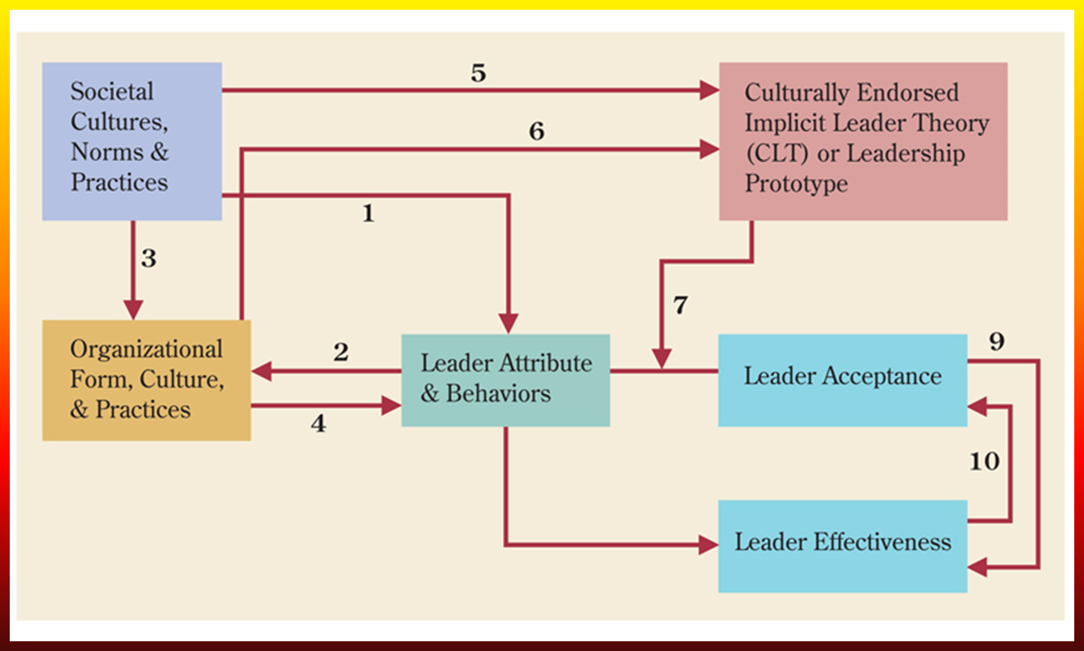
14-<number>
Copyright © 2010 John Wiley & Sons, Inc.

Slide 17
Leader Dimensions Associated With Effectiveness
Assertiveness
Future orientation
Gender egalitarianism
Uncertainty avoidance
Power distance
Institutional emphasis
In-group collectivism
Performance orientation
Humane orientation
Copyright © 2010 John Wiley & Sons, Inc.
14-<number>

Slide 18
GLOBE Leadership Dimensions
Charismatic/value based
Team-oriented
Participative
Humane-oriented
Autonomous
Self-protective
Copyright © 2010 John Wiley & Sons, Inc.
14-<number>

Slide 19

Key applications of GLOBE
  Dimensions of effective leadership must be matched with the culturally ‘endorsed’ leadership style.
  Integrity and shared leadership are important leadership dimensions across most cultures.
14-<number>
Copyright © 2010 John Wiley & Sons, Inc.

Slide 20

To increase effectiveness in today’s dynamic environments
  Top management teams (TMTs) must possess a diversity of skills, experiences, and theoretical frameworks for strategic planning.
14-<number>
Copyright © 2010 John Wiley & Sons, Inc.

Slide 21

Multiple-Level Leadership
  There are three different organizational domains from the bottom to the top of the organization.
  The production domain at the bottom of the organization;
  The organization domain in the middle levels;
  The systems domain at the top.
14-<number>
Copyright © 2010 John Wiley & Sons, Inc.

Slide 22

Behavioral complexity
  Leaders who have a broad range of role behaviors are more likely to be effective.
Cognitive complexity
  Leaders who process information differently and perform certain tasks better than less cognitively complex persons.
Copyright © 2010 John Wiley & Sons, Inc.
14-<number>

Slide 23

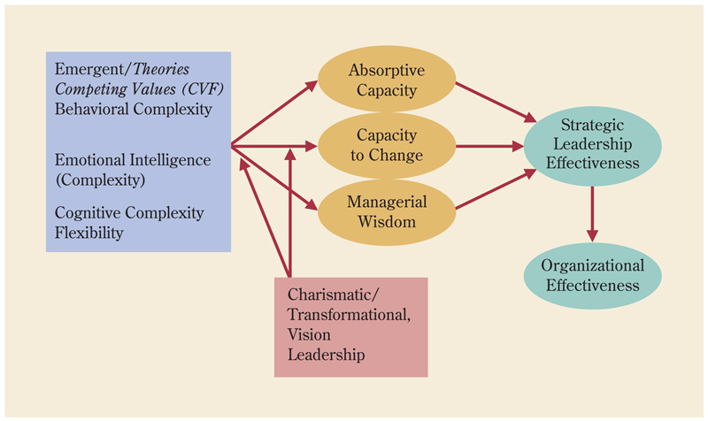
Copyright © 2010 John Wiley & Sons, Inc.
14-<number>

Slide 24
Strategic Leadership in the Middle
  The need for continuous innovation and adaptability in contemporary organizations calls for leadership from every organizational level.
  Contextual leadership
    Assessment of the opportunities and constraints that arise in specific situations, and the behaviors needed to address them.
Copyright © 2010 John Wiley & Sons, Inc.
14-<number>

Slide 25

Contexts for Leadership Action
  Stability
  Crisis
    Sudden threats require action and prominent leadership.
  Dynamic Equilibrium
    Programmed efforts shift with priorities.
  Near the Edge of Chaos
    Requires rapid adjustment to uncertain situations.
Copyright © 2010 John Wiley & Sons, Inc.
14-<number>

Slide 26
Patterning of attention
  Leadership behavior aimed at stimulating discussion and problem resolution.
  Leader isolates, synthesizes, and communicates important information from diverse stream of events, actions, and outcomes.
Copyright © 2010 John Wiley & Sons, Inc.
14-<number>

Slide 27

Network development
  Leadership behavior that stimulates problem resolution.
    Developing and managing the connections among individuals, both inside and outside of the unit, or the firm.
14-<number>
Copyright © 2010 John Wiley & Sons, Inc.

Slide 28

Change leadership
  Deals with the idea that an organization must master the challenges of change while creating a satisfying, healthy, and effective workplace for its employees.
14-<number>
Copyright © 2010 John Wiley & Sons, Inc.

Slide 29

Transformational change
  Radically shifts the fundamental character of an organization.
Incremental change
  Builds on the existing ways of operating, to enhance or extend them in new directions.
Copyright © 2010 John Wiley & Sons, Inc.
14-<number>

Slide 30
Unplanned change
  Spontaneous, and without a change agent’s direction.
Planned change
  Intentional, and occurs with a change agent’s direction.
14-<number>
Copyright © 2010 John Wiley & Sons, Inc.

Slide 31

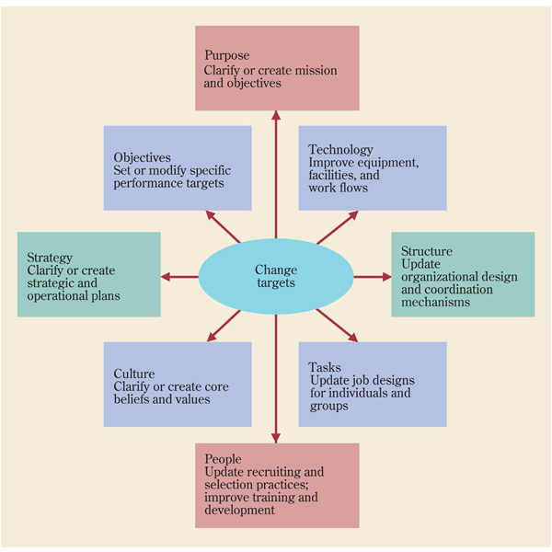
14-<number>
Copyright © 2010 John Wiley & Sons, Inc.

Slide 32
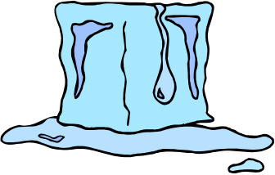
Unfreezing
The situation is prepared for a change.
Encourages the replacement of old behaviors and attitudes with new behaviors.
Entails devising ways to reduce barriers to change.
14-<number>
Copyright © 2010 John Wiley & Sons, Inc.

Slide 33


Changing
  Specific actions are taken to create change.
  Helps employees learn new concepts or points of view.
  Role models, mentors, experts, benchmarking results, and training are useful mechanisms to facilitate change.
14-<number>
Copyright © 2010 John Wiley & Sons, Inc.

Slide 34
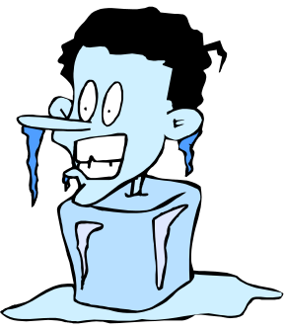
Refreezing
  Changes are reinforced and stabilized.
  Leader (change agent) integrates the changed behavior or attitude into the normal way of doing things.
  Coaching and modeling help reinforce the stability of change.
Copyright © 2010 John Wiley & Sons, Inc.
14-<number>

Slide 35


Force-coercion strategy
  Uses authority, rewards, and punishments to create change.
Copyright © 2010 John Wiley & Sons, Inc.
14-<number>

Slide 36
Rational persuasion strategy
  Uses facts, special knowledge, and rational argument to create change.
14-<number>
Copyright © 2010 John Wiley & Sons, Inc.

Slide 37
Shared-power strategy
  Uses participatory methods and emphasizes common values to create change.
Copyright © 2010 John Wiley & Sons, Inc.
14-<number>

Slide 38
Resistance to change
  An attitude or behavior that shows unwillingness to make or support a change.
Copyright © 2010 John Wiley & Sons, Inc.
14-<number>

Slide 39
Why people resist change
  Resistance to the change itself.
  Resistance to the change strategy.
  Resistance to the change agent.
Copyright © 2010 John Wiley & Sons, Inc.
14-<number>

